Slide 1
VHF Antenna Systems and Reception
A Study into the Improvement of Over the Air Television Antenna Systems
Mark J. Colombo

Slide 2
Contents
DTV Transition
DTV and its Problems
VHF Antenna Design
Testing Procedure
Desired Results
Wider Implications
Conclusion

Slide 3
DTV Transition
Japanese analog HDTV system in 1980s
Digital HDTV system
Original transition date: December 31, 2006
First commercial station in 1997
Deficit Reduction Act of 2005
  Set February 17, 2009 as transition date
Delayed in February 2009 to June 12, 2009

Slide 4
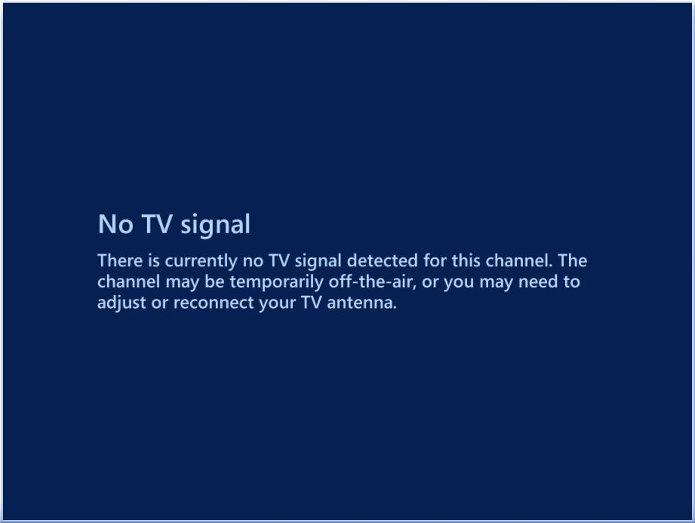
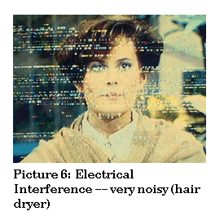
DTV and its Problems
Procrastination
Severe VHF reception problems
  Electrical noise
  Weak signals
  Poor antennas
(Image courtesy KYES Anchorage)

Slide 5
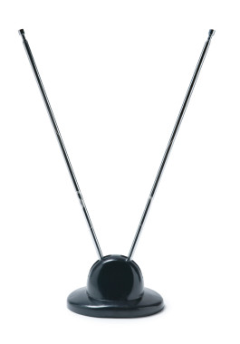
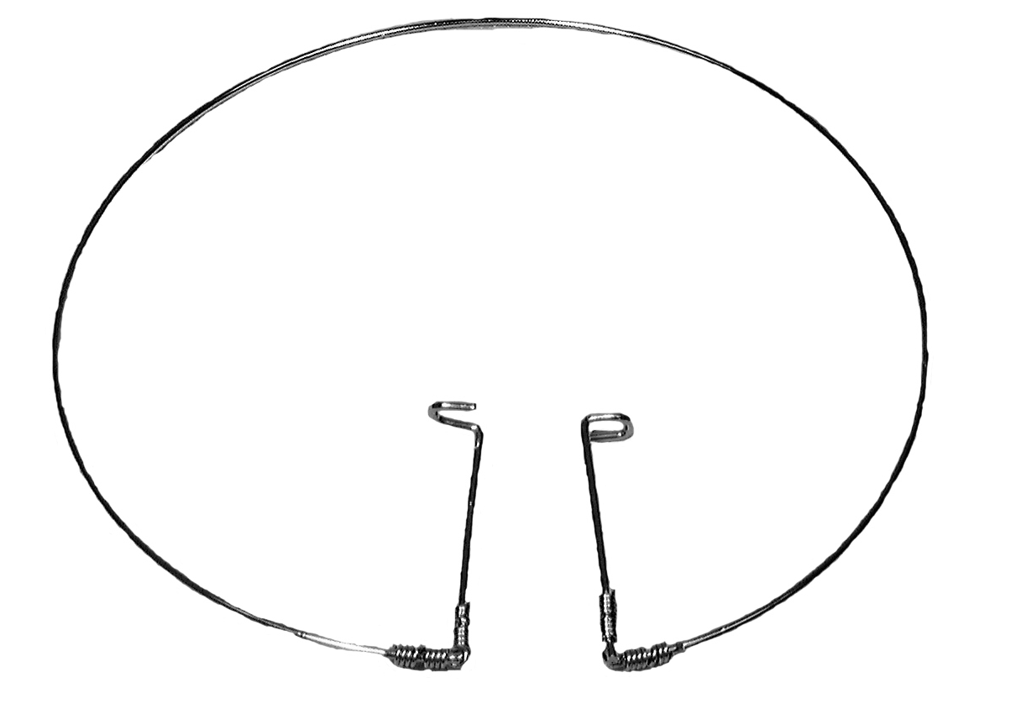
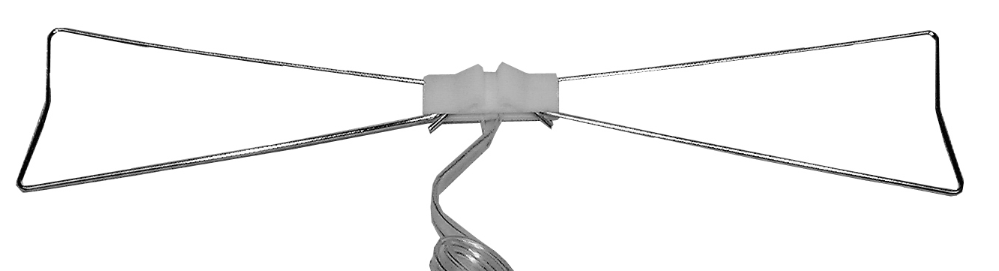
VHF Antenna Design
Most are “rabbit ear” dipoles
Project will scale UHF antennas
Test new designs
(Image courtesy Farnsworth Electronics)
(Image courtesy Free Stock Photos)
(Image courtesy SDPB)

Slide 6
Testing Procedure
Build several VHF antenna designs
Test theoretical performance with software
Test optimal real world performance
  Using spectrum analyzer
Test typical real world performance
  Using spectrum analyzer and consumer receiver
  This test will provide most helpful information

Slide 7
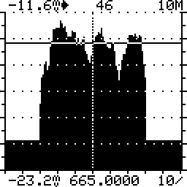
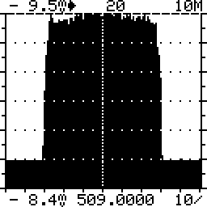
Desired Results
Superior VHF antenna design
  Maximizes signal level
  Minimizes multipath reflections
  Improves indoor reception
(Images produced on a Sencore SLM1456CM spectrum analyzer)

Slide 8
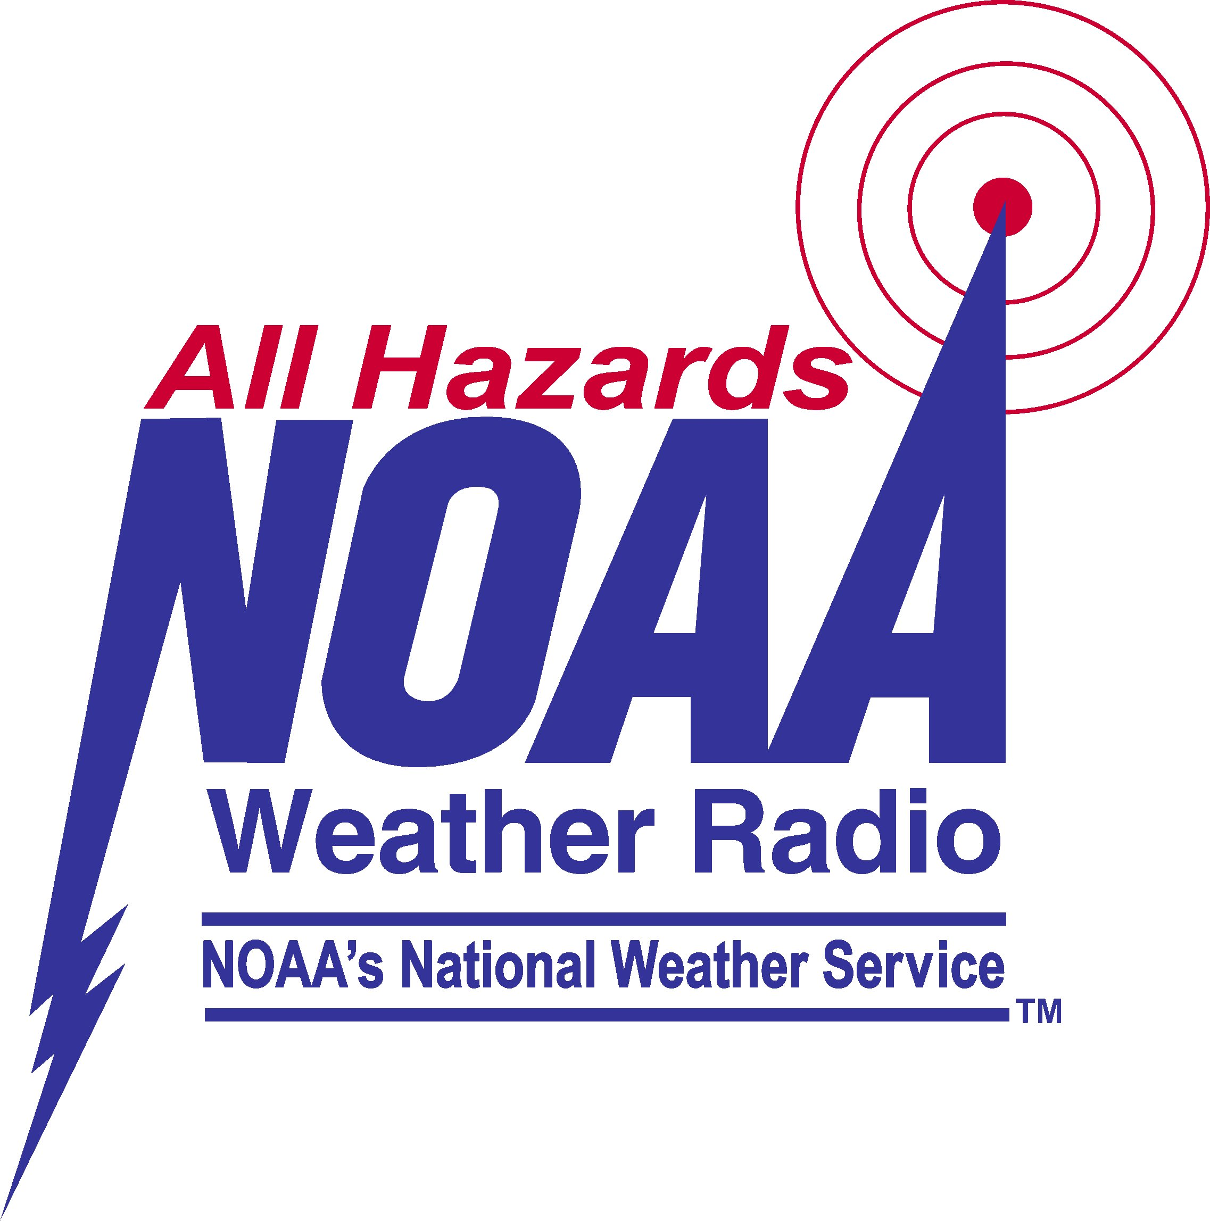
Wider Implications
Military uses
National Weather Service radios
Broadband services

Slide 9
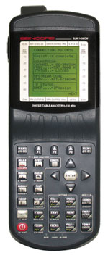
Conclusion
Indoor VHF antenna design is worth study
Spectrum analyzer demo after class
Questions?

